Slide 1
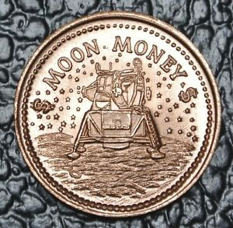
GET YOUR MARS MONEY!

Slide 2
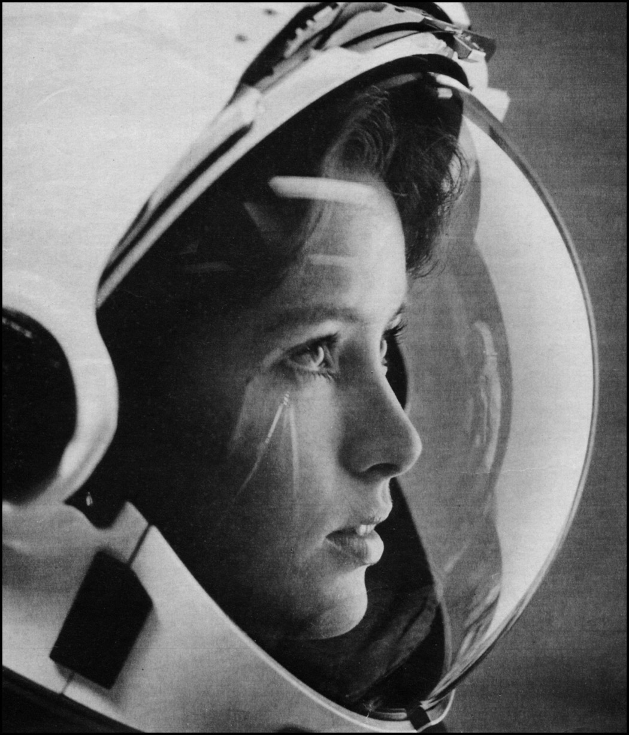
WHO WAS THE FIRST WOMAN IN SPACE?
Time: 60 sec
Get 20

Slide 3
SHOW US YOUR ‘MARS WALK’.
UPLOAD HERE:
#marsonearth
Get 200
150

Slide 4
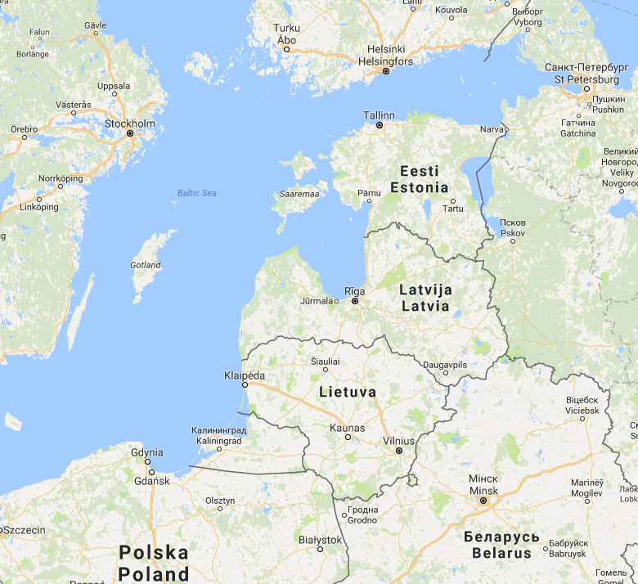
WHERE IS AKMENE?
Time: 10 secs
Get 50

Slide 5
TAKE A SELFIE ON MARS.
Upload here:
#marsonearth
Get 150

Slide 6
DRAW A MARTIAN
UPLOAD HERE:
#marsonearth
Get 120

